Slide 1
Artificial Intelligence
Feature Extraction II

Slide 2
Overview
New material: dealing with complex/unstructured data
Finishing our work towards bag of visual words (BOVW)

Slide 3
Second term topics: details
Data exploration and preparation (1 week)
We need to add some of the basic bits we skipped last term
Evaluation (2 weeks)
Really important: we all need to know the important methods for establishing exactly how well our ML methods are performing
Feature extraction (2 weeks)
Really interesting topic: if our data doesn’t have a really obvious consistent structure (e.g., text documents, images) then how should we extract features
Support Vector Machines (2 weeks)
A final “black box” technique we think you should have some exposure to (e.g., visualising, tuning hyperparameters)
Then over to Deep Learning with Nick (3 weeks, not assessed)

Slide 4
Last week’s reading
Hopefully you completed the reading on:
K-means clustering [specific]
“Bag of visual words” (BOVW) [overview]
Quite a lot of little steps…
(All possible in Matlab – chance to try in labs)
…But essentially we make a histogram over a common “vocabulary” of patch-based image features
This gives us an equal number of features for each image, even where they may have very different sizes and/or compositions

Slide 5
Exam preparation questions
See for practice questions: they cover more ideas/methods, they’re getting a bit harder… But hopefully more interesting too…
…We did a fuller overview last week, have a look back if you missed it
…Thought about having a question on actually building a BOVW, but the size of the image databases we’d have to download makes it difficult…
…So the key thing is to make sure you’re happy with explaining steps in the process (there is a question on this) and happy applying K-means (there is a question on this)

Slide 6
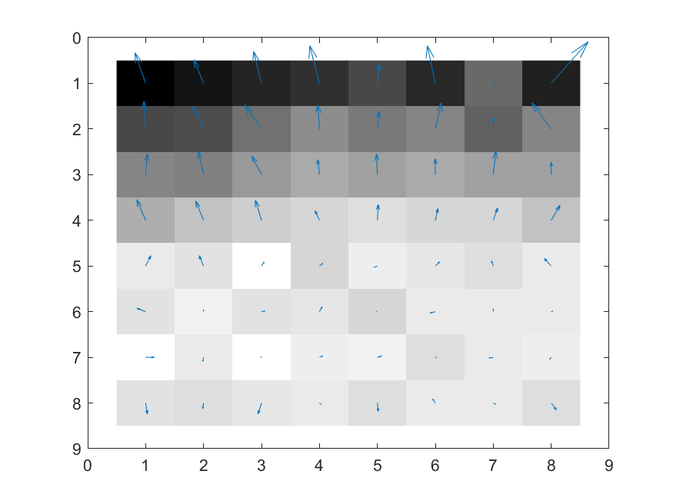
Local gradients plus pixels

Slide 7
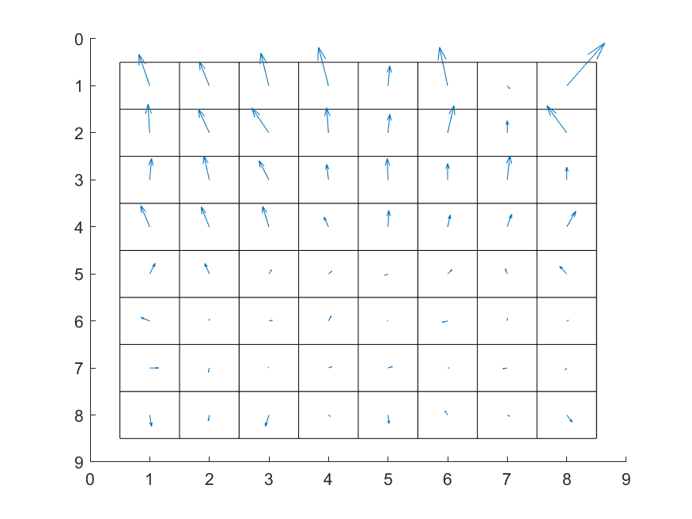
Local gradients without pixels

Slide 8
Local gradients
Pretty much all patch-based representations work with these local gradients (HOG, SIFT, …, etc.)
They all then try to compress them down into a more compact representation (e.g., averaging to give fewer numbers)…
And try to store them in such a way that they are insensitive to things like lighting changes (e.g., normalising gradients across patches)…
They each have a slightly different approach…
…But let’s look at a step that’s common to most

Slide 9
Build a histogram of oriented gradients

Slide 10
Build a histogram of oriented gradients
For each local gradient
Find the nearest bin and add one:

Slide 11
Build a histogram of oriented gradients
20
13
8
5
4
5
3
6

Slide 12
Build a histogram of oriented gradients
20
13
8
5
4
5
3
6
20 | 8 | 4 | 3 | 6 | 5 | 5 | 13
…

Slide 13
Build a histogram of oriented gradients
20
13
8
5
4
5
3
6
Your features:
20 | 8 | 4 | 3 | 6 | 5 | 5 | 13
…

Slide 14
Invariance
There are more than 8 features per patch in reality…
…Because HOG does other clever things to try and build invariance to things like illumination changes
…But it is a multiple of the number of bins in the histogram
Had wanted to talk about other forms of invariance this week – but there just isn’t time
Most patch representations are invariant to changes in rotation or scale or both*
–
* Not needed for the exam, but good to know

Slide 15
Image classification: scenario 1
Simplest application of patch-based features
Not requiring complex approaches to invariance
But requiring tightly constrained problems
Images are the same size
Composition is the same (e.g., tightly cropped to object of interest)
Illumination reasonably consistent
We can reasonably make comparisons between corresponding patches in two images (top left, top right, bottom left, …)
E.g. passport photos
Main thing we need to consider: what patch size is appropriate?

Slide 16
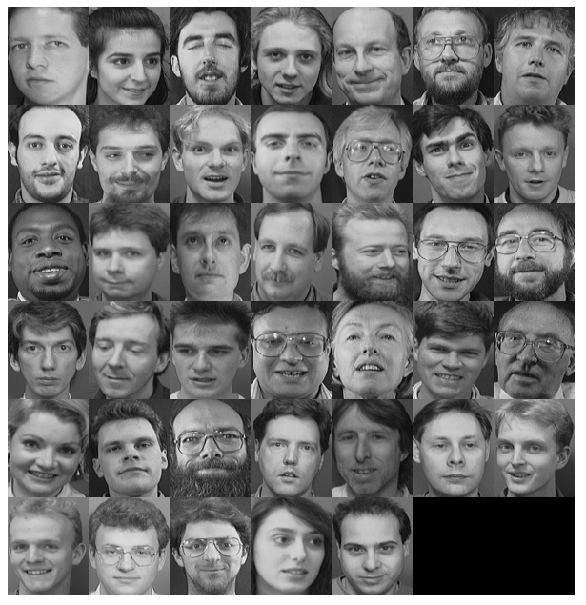
Faces montage from labs

Slide 17
Faces montage from labs
Broadly speaking, the same part of the image contains the same part of the object

Slide 18
Image classification: scenario 2
We’re now interested in more unconstrained problems
Different sized images
Different compositions
Diverse object categories
Other objects present too

Slide 19
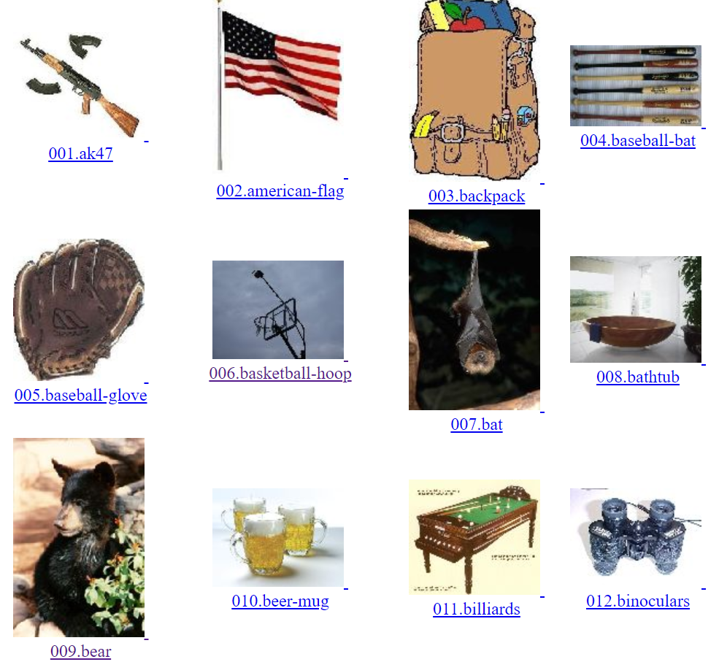
Caltech 101/256
Lots more categories…
http://www.vision.caltech.edu/Image_Datasets/Caltech256/images/

Slide 20
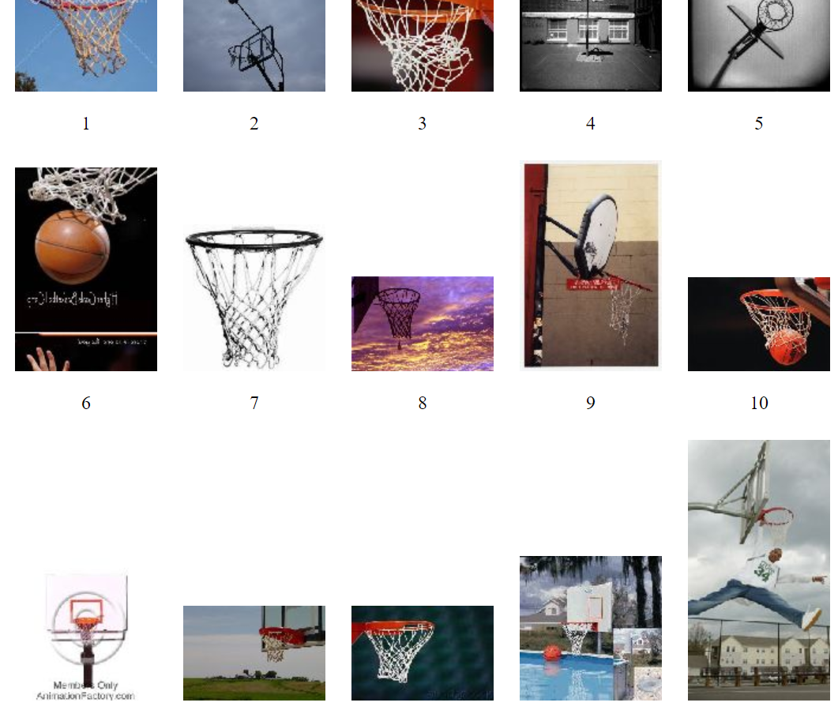
Caltech 101/256: “basketball” class
Lots more examples…
http://www.vision.caltech.edu/Image_Datasets/Caltech256/images/

Slide 21
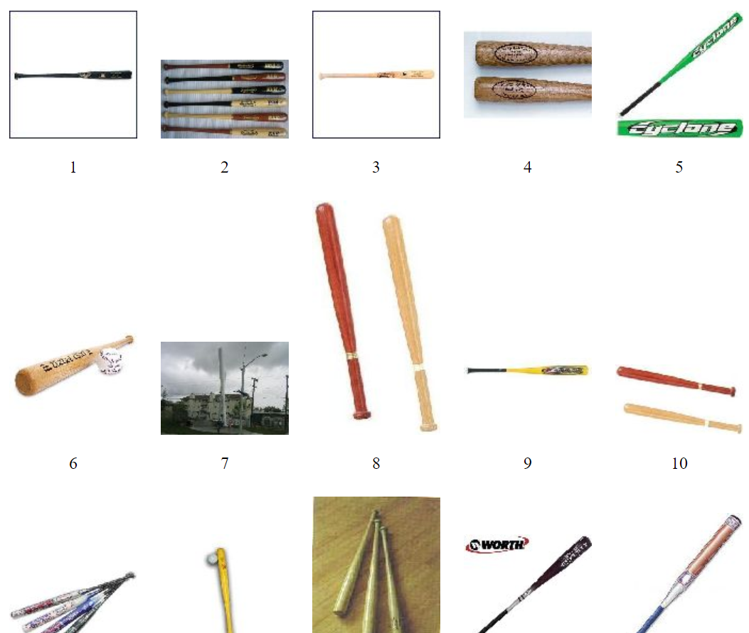
Caltech 101/256: “baseball” class
Lots more examples…
http://www.vision.caltech.edu/Image_Datasets/Caltech256/images/

Slide 22
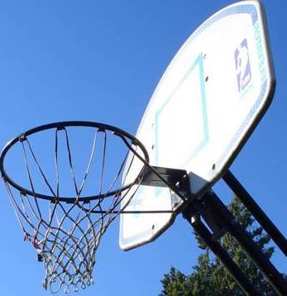
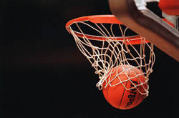
Extract patch-based features

Slide 23
Extract patch-based features
Not only do the patches contain completely different things, but there are different numbers of patches in different images…

Slide 24
Extract patch-based features
22*21=462 patches
10*15=150
Not only do the patches contain completely different things, but there are different numbers of patches in different images…

Slide 25
Extract patch-based features
22*21=462 patches
10*15=150
The examples don’t even sit in the same feature space… So how could we begin to train a classifier (e.g., k-NN)?

Slide 26
How to proceed?
In the BOVW approach we first think about all the patches individually
Every HOG patch leads to the same number of numbers: N
Plot every one of them as a single point in an N-dimensional feature space
Think about the patterns we get, and look for groups (“clusters”)
We’re going to do this, but a simulated example in a low-dimensional space

Slide 27
Simulated example
There will be just 2 features per patch (so we can plot them easily)
The things we’ll see are true more generally, but the data isn’t real (it’s synthetic data, generated by me for the lecture)
In a real scenario, the same things hold true, but…
The space is much higher dimensional (many features per patch); there may be much larger (average) numbers of patches per image; there may be a larger number of (more diverse) clusters…
…And, most important, visualisation is much harder*
* We’ll come back to this…

Slide 28

(If it helps…)
You can think of HOG features that only consider two different gradient orientations…
…Or about applying PCA to normal HOG features and retaining only the first two PCs…
52
12

Slide 29
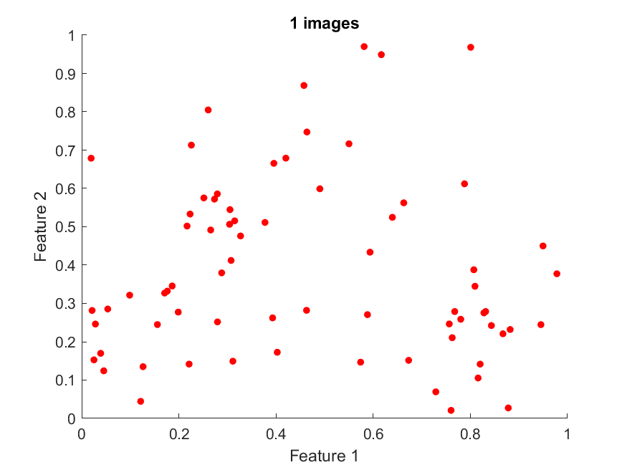
Distribution of patch features (basketball)

Slide 30
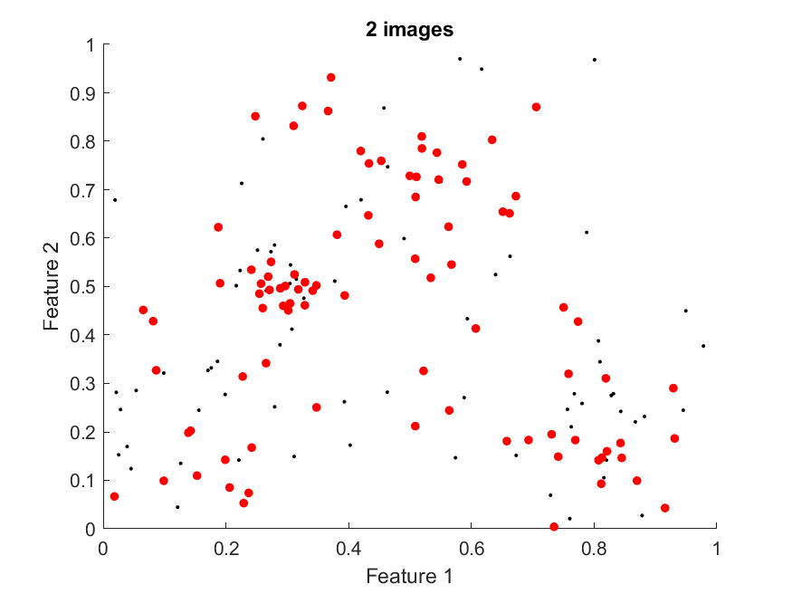
Distribution of patch features (basketball)

Slide 31
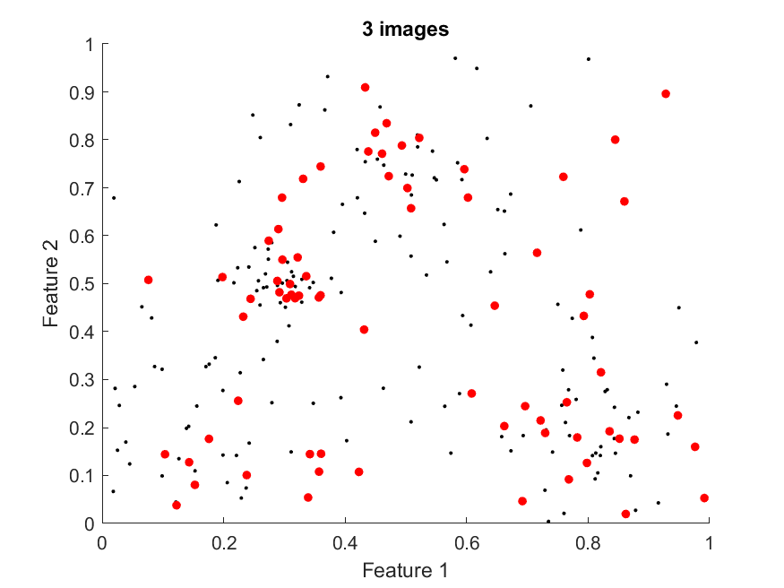
Distribution of patch features (basketball)

Slide 32
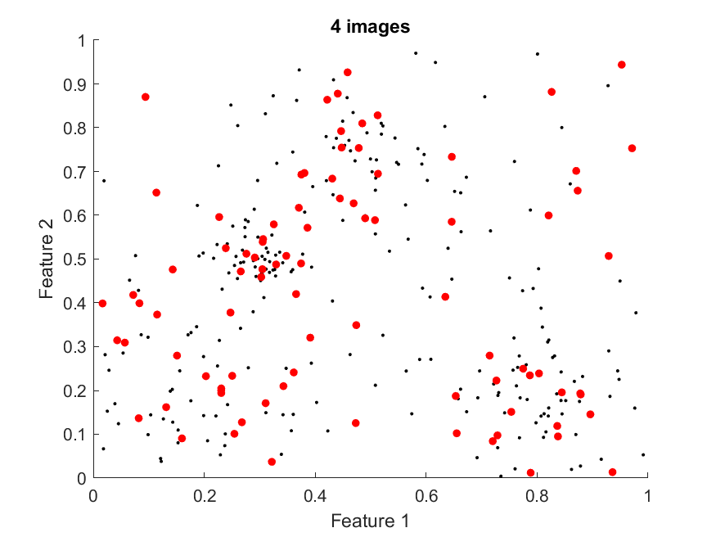
Distribution of patch features (basketball)

Slide 33
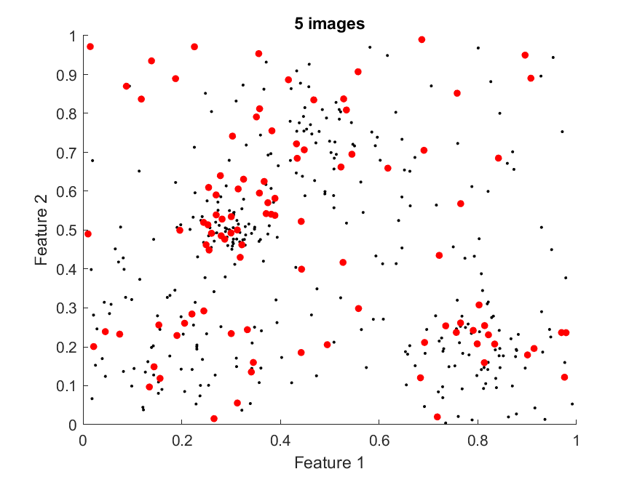
Distribution of patch features (basketball)

Slide 34
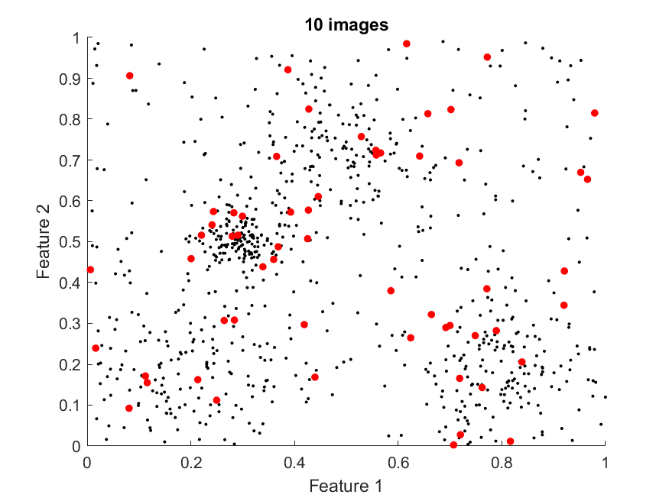
Distribution of patch features (basketball)

Slide 35
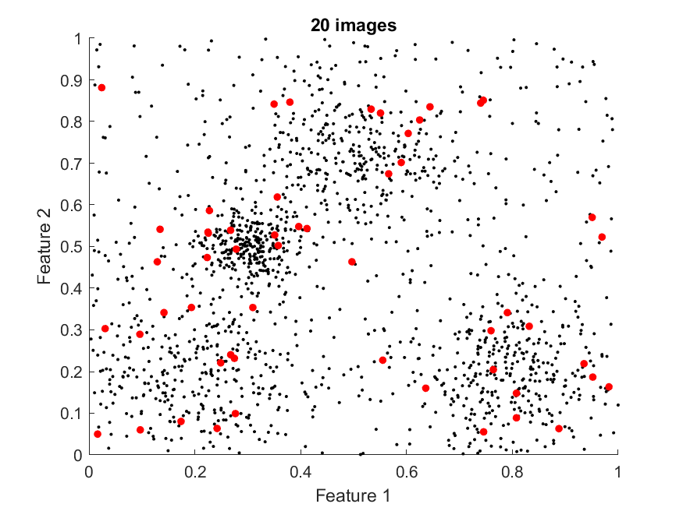
Distribution of patch features (basketball)

Slide 36
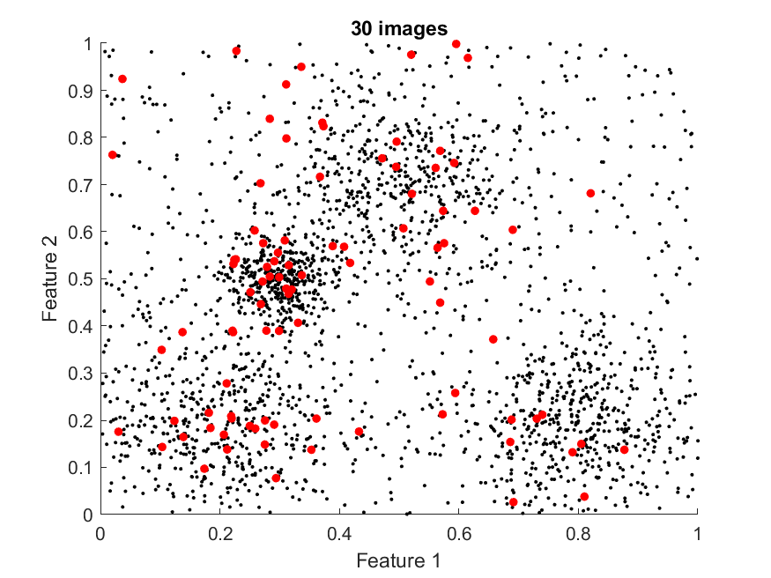
Distribution of patch features (basketball)

Slide 37
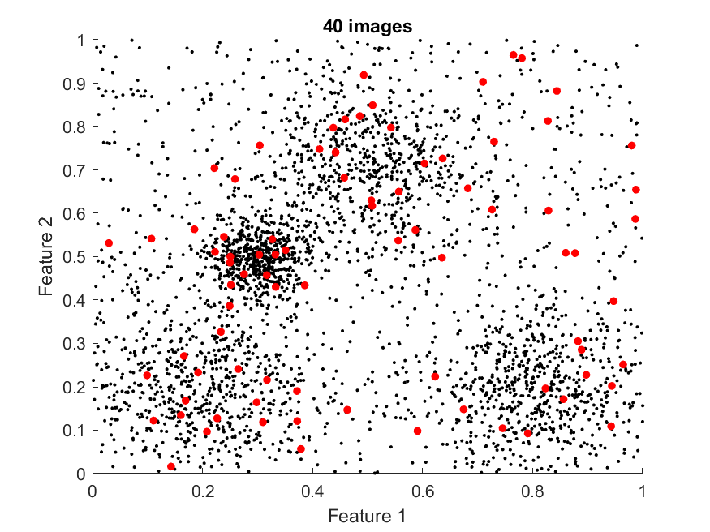
Distribution of patch features (basketball)

Slide 38
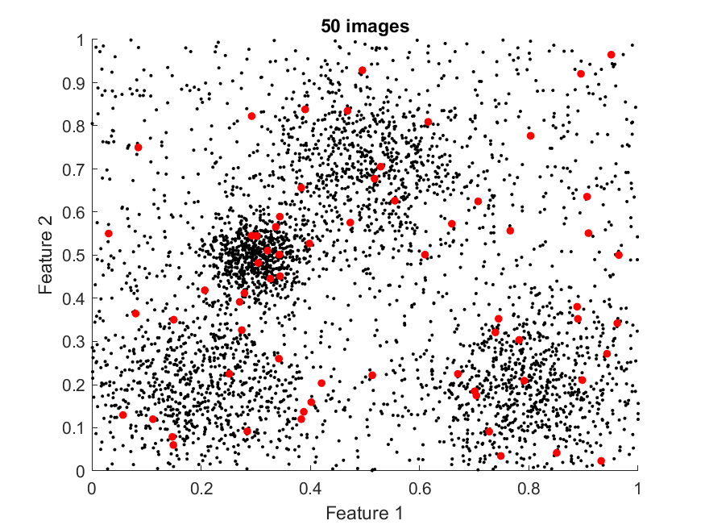
Distribution of patch features (basketball)

Slide 39
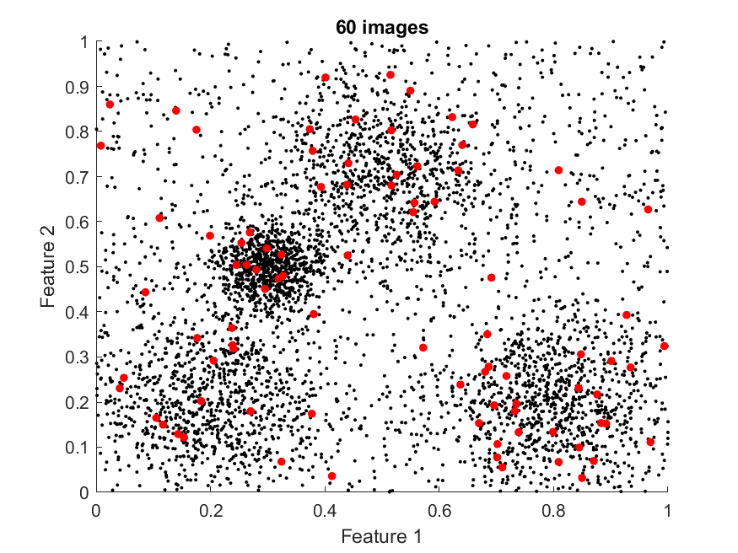
Distribution of patch features (basketball)

Slide 40
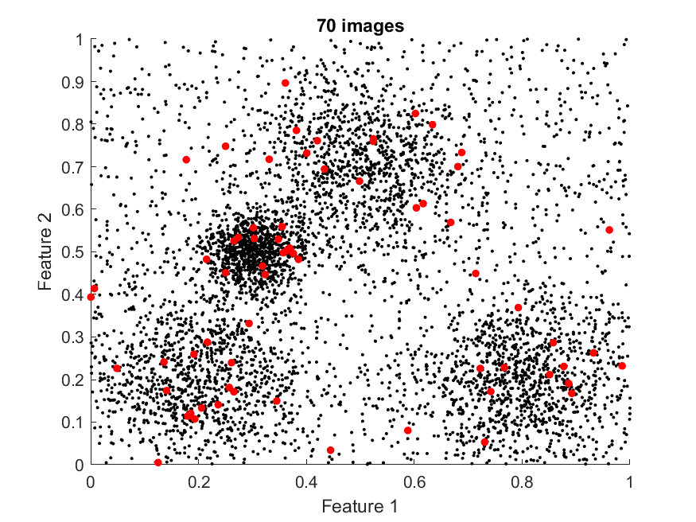
Distribution of patch features (basketball)

Slide 41
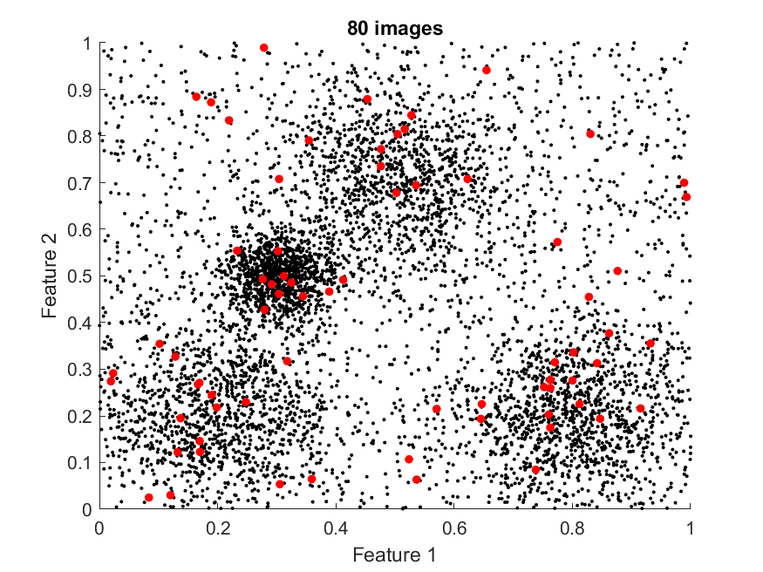
Distribution of patch features (basketball)

Slide 42
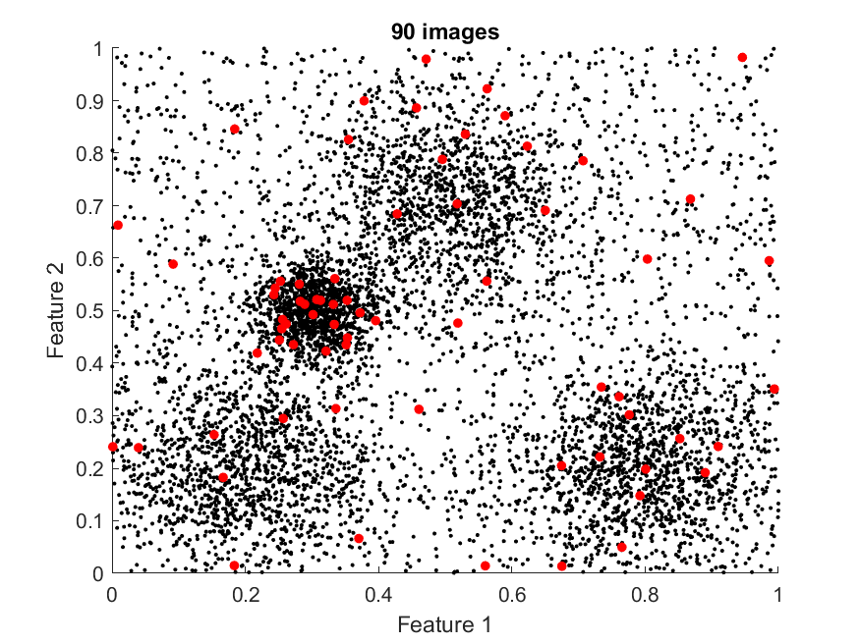
Distribution of patch features (basketball)

Slide 43
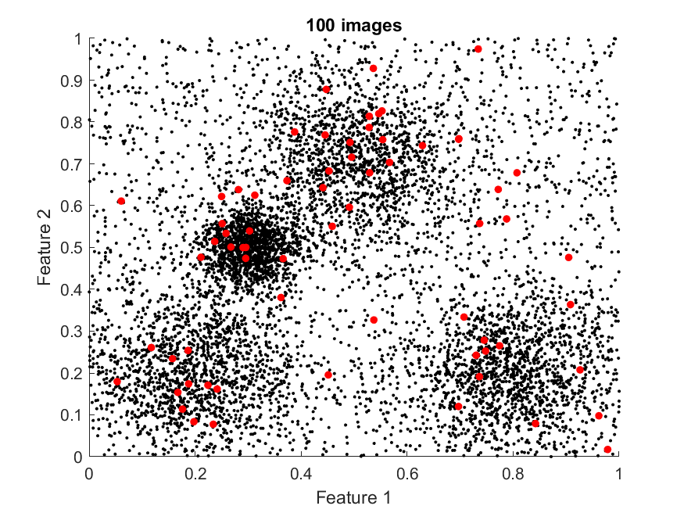
Distribution of patch features (basketball)

Slide 44

Distribution of patch features (basketball)

Slide 45
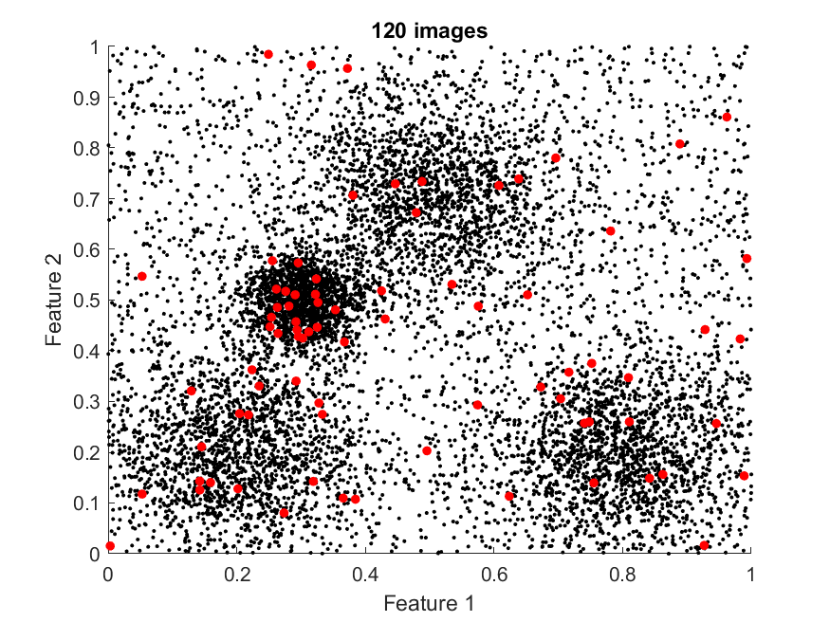
Distribution of patch features (basketball)

Slide 46
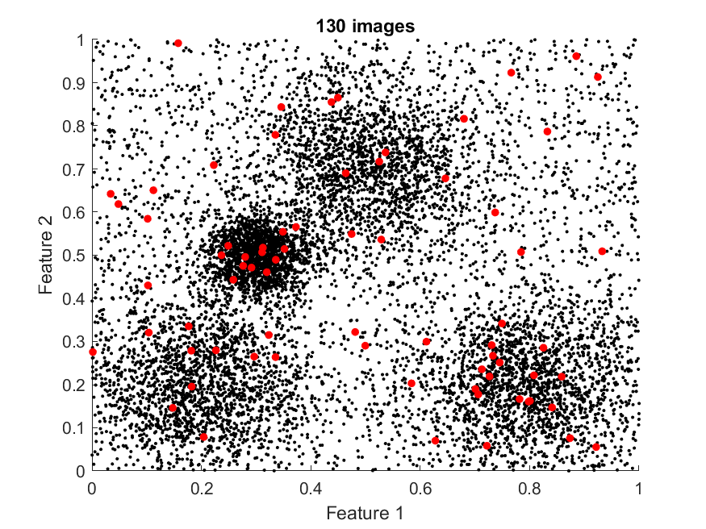
Distribution of patch features (basketball)

Slide 47
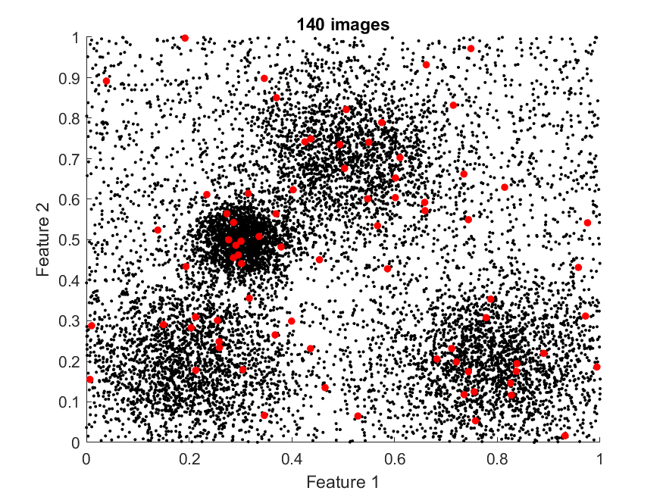
Distribution of patch features (basketball)

Slide 48
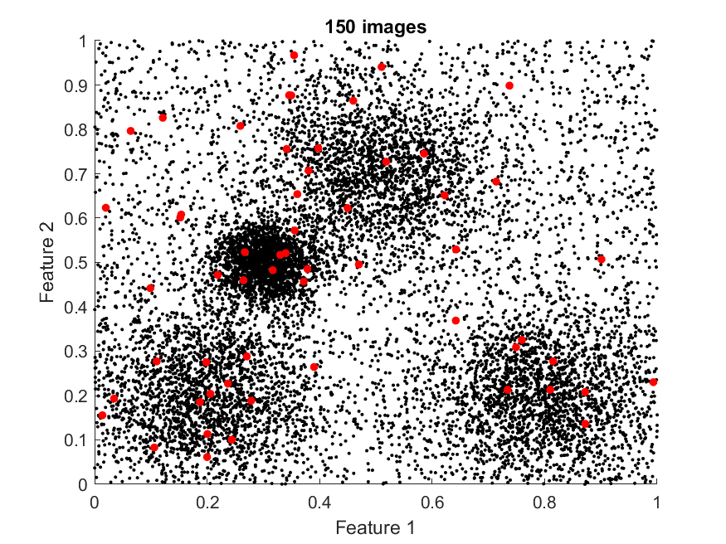
Distribution of patch features (basketball)

Slide 49
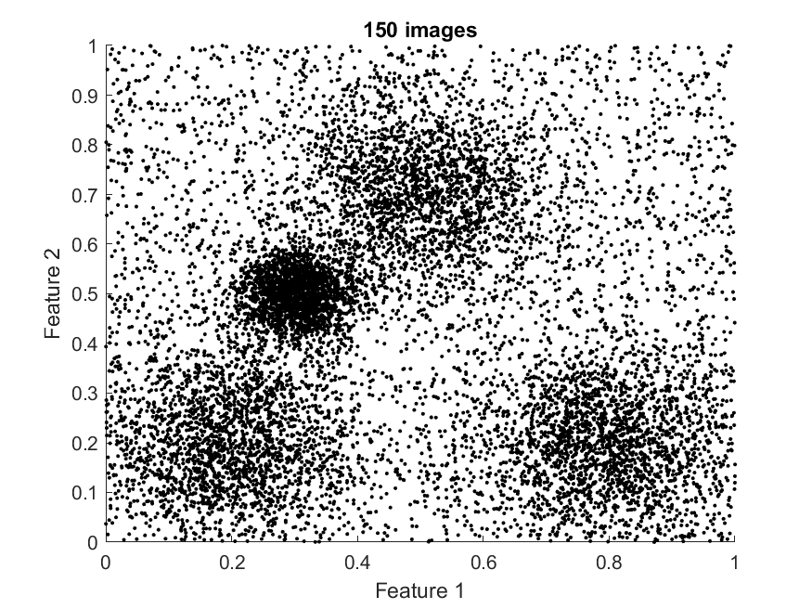
Distribution of patch features (basketball)
Full video available on Moodle

Slide 50
Ideas
You can see that clusters have become visible in the feature space
There are certain kinds of feature that tend to recur in these “basketball” images
They aren’t exactly the same…
But they are similar…

Slide 51
Ideas
New idea: use the clusters to simplify our representation of each image
Find each of the clusters, give them each a unique number, e.g., {1, 2, 3, 4}
For every feature patch, just record which cluster it lies closest to…
I = {3, 3, 1, 2, …, 4}

Slide 52
Ideas
Can then represent an image of any size with a histogram showing the number of patches in each cluster…
…Nice because images of different sizes now live in the same feature space…
Here a 4D space
No. of patches
Cluster number
No. of patches
Cluster number

Slide 53
Ideas
Larger images would tend to have taller histograms…
…But we can take simple steps to ensure we think about the shape of the histograms rather than their absolute sizes
E.g., min-max normalisation…
Or just thinking about %ages rather than total numbers
% of patches
Cluster number
% of patches
Cluster number

Slide 54
Problems
We’re not only interested in a simplified representation of “basketball” images…
We want to be able to tell between images from several different classes…
What does the feature space tend to look like when we add patches from a new class?
E.g., “baseball”
Again, let’s look at a simulated example in a low-dimensional space

Slide 55
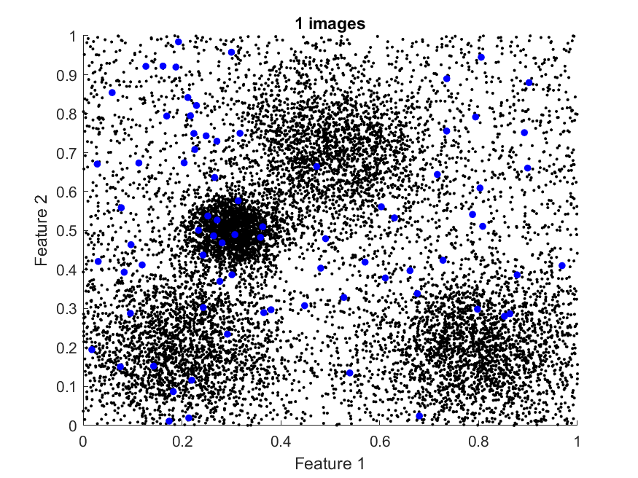
Distribution of patch features (baseball)

Slide 56
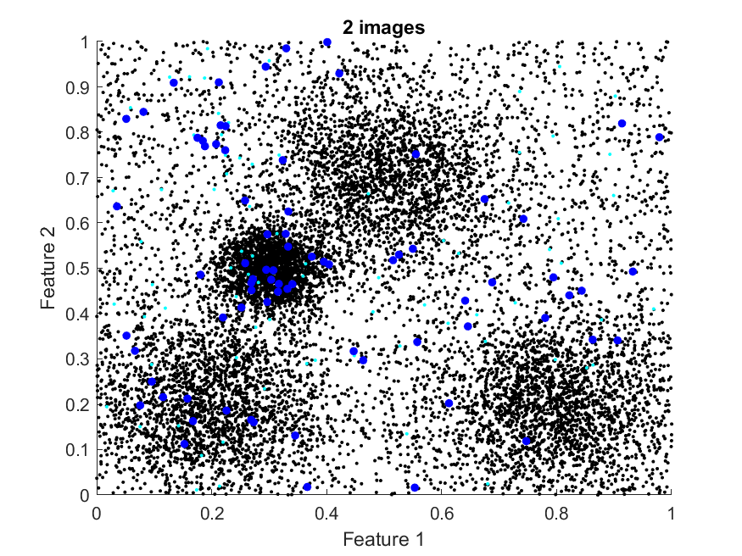
Distribution of patch features (baseball)

Slide 57
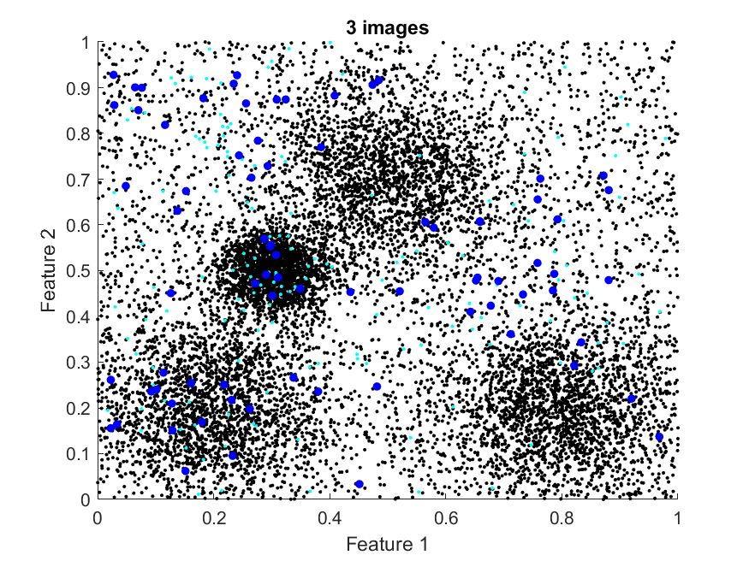
Distribution of patch features (baseball)

Slide 58
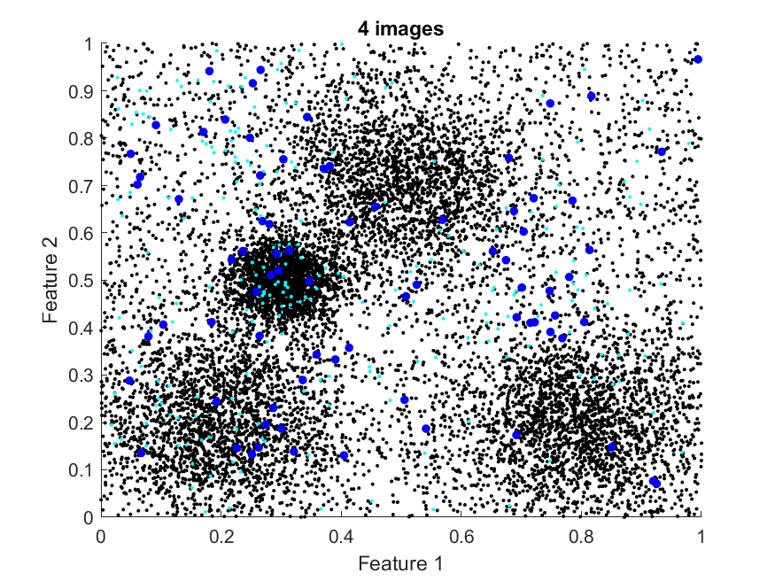
Distribution of patch features (baseball)

Slide 59
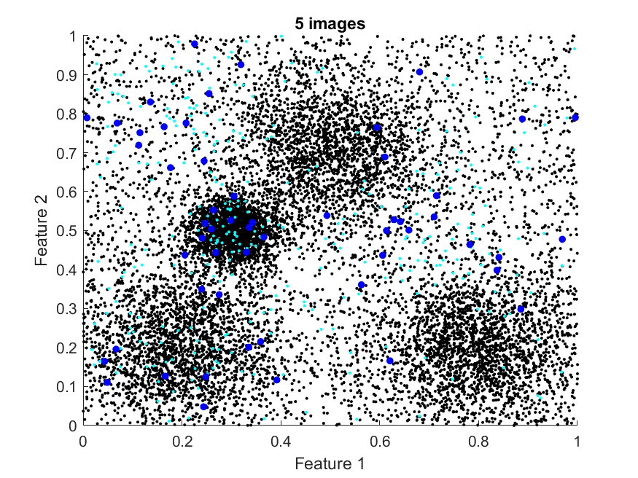
Distribution of patch features (baseball)

Slide 60
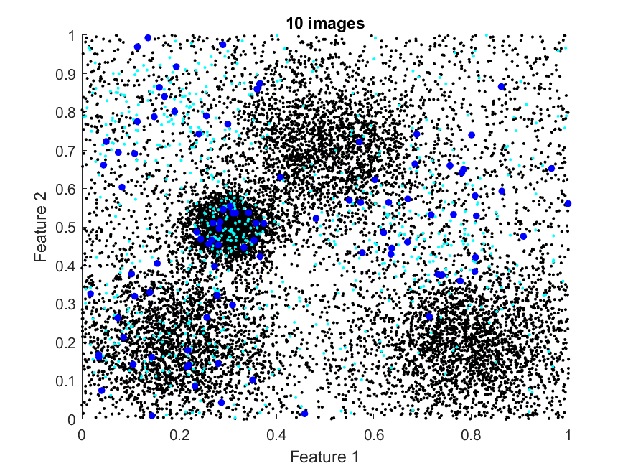
Distribution of patch features (baseball)

Slide 61
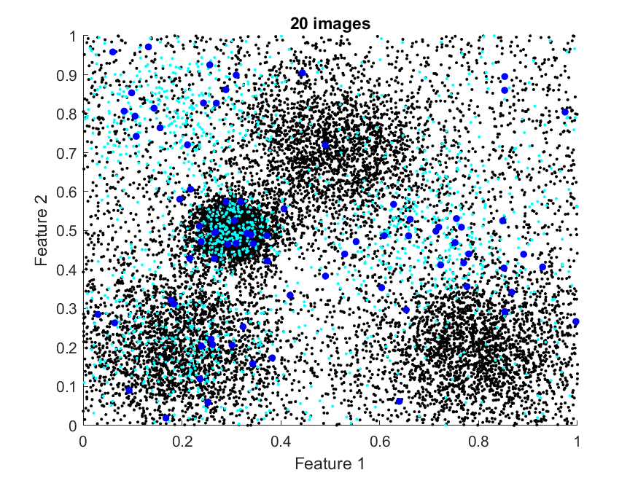
Distribution of patch features (baseball)

Slide 62
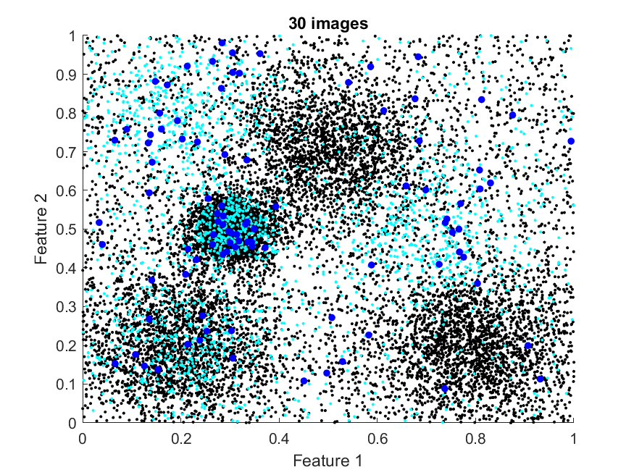
Distribution of patch features (baseball)

Slide 63
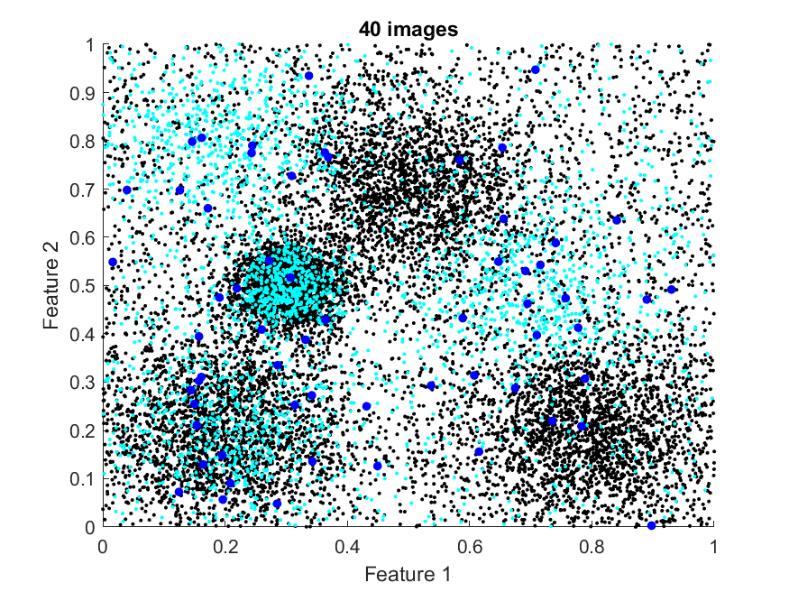
Distribution of patch features (baseball)

Slide 64
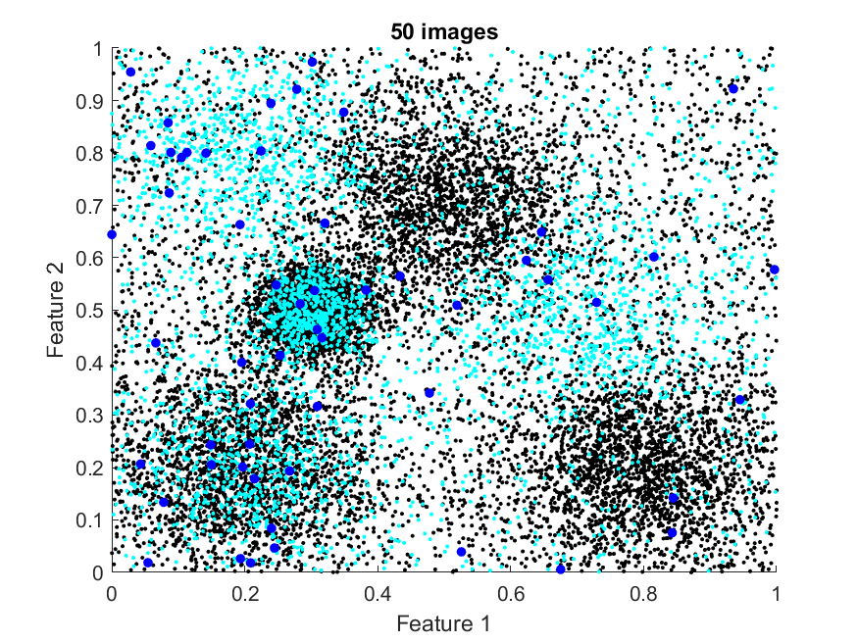
Distribution of patch features (baseball)

Slide 65
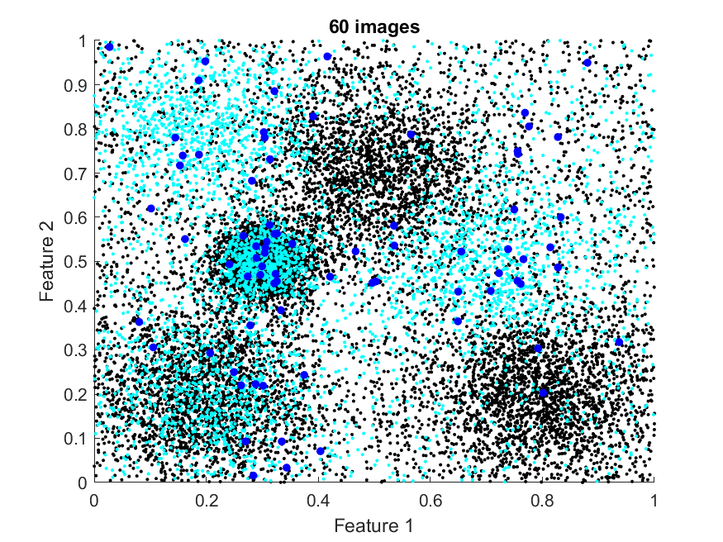
Distribution of patch features (baseball)

Slide 66
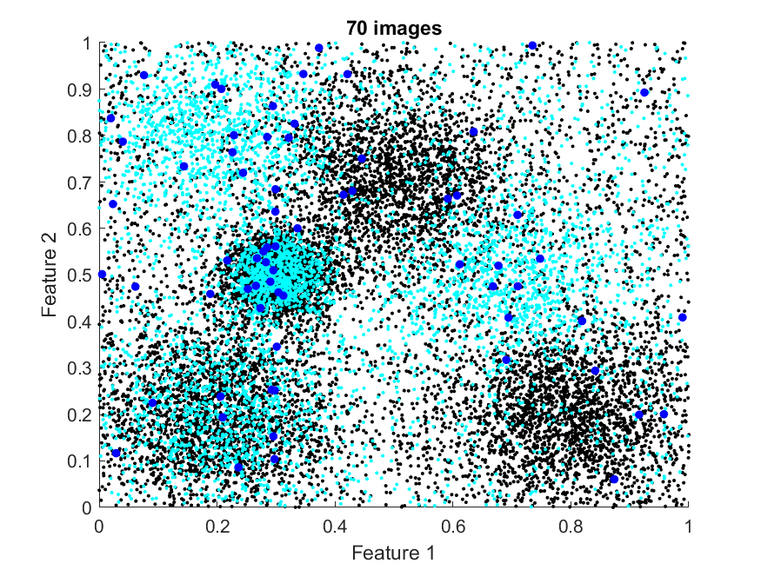
Distribution of patch features (baseball)

Slide 67
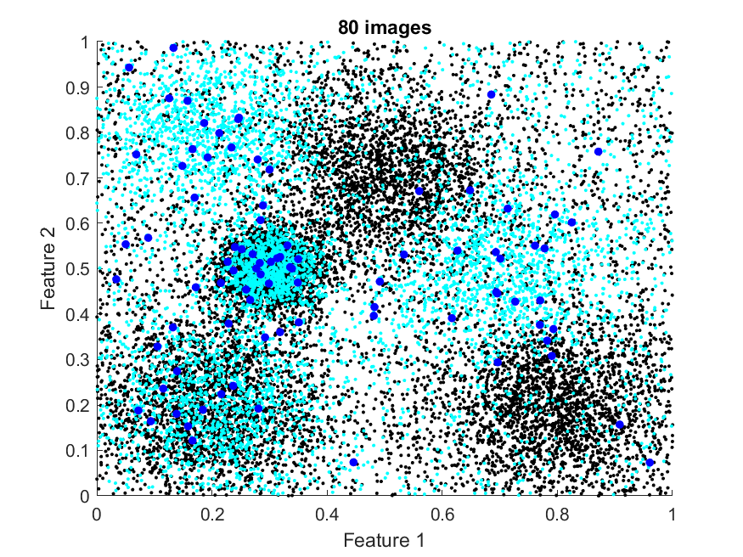
Distribution of patch features (baseball)

Slide 68
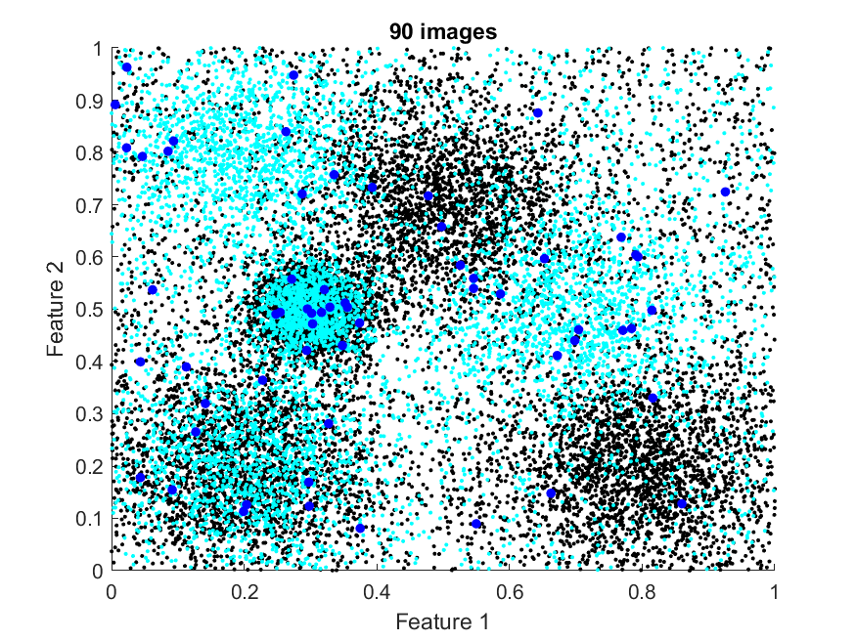
Distribution of patch features (baseball)

Slide 69
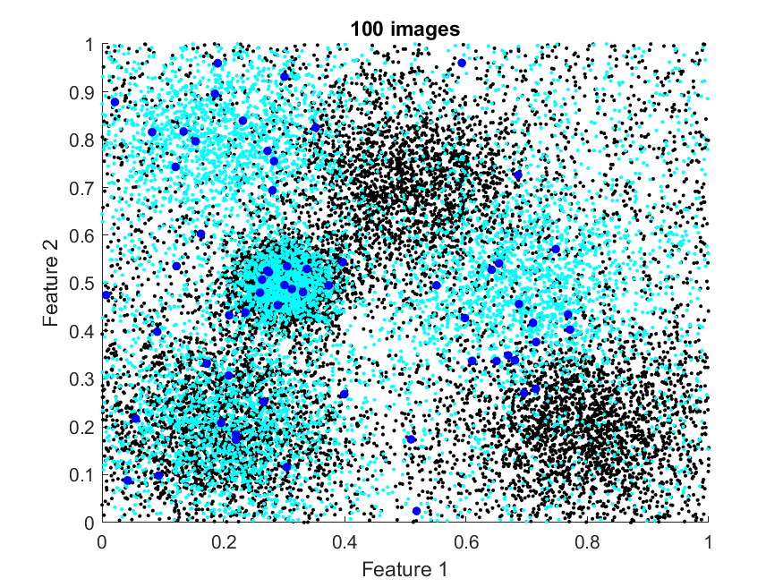
Distribution of patch features (baseball)

Slide 70
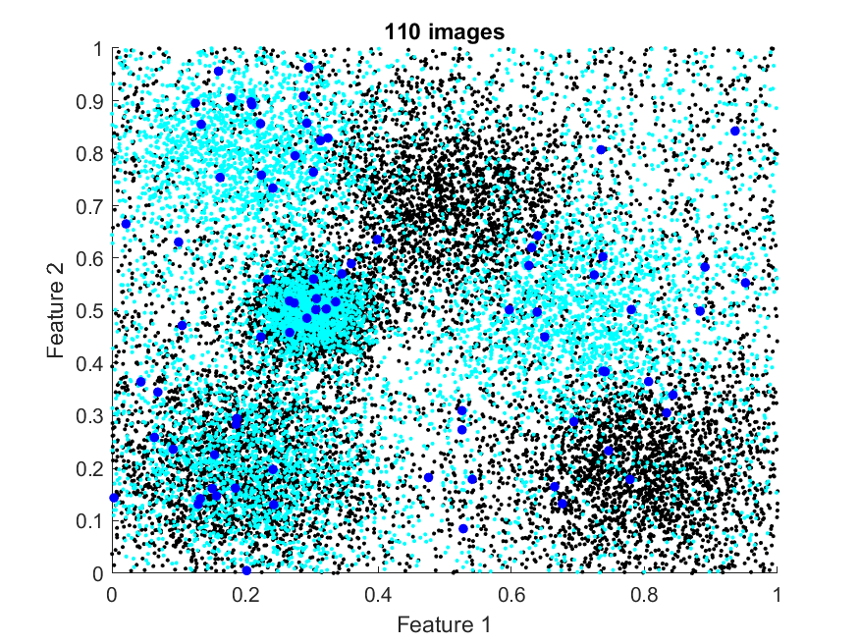
Distribution of patch features (baseball)

Slide 71
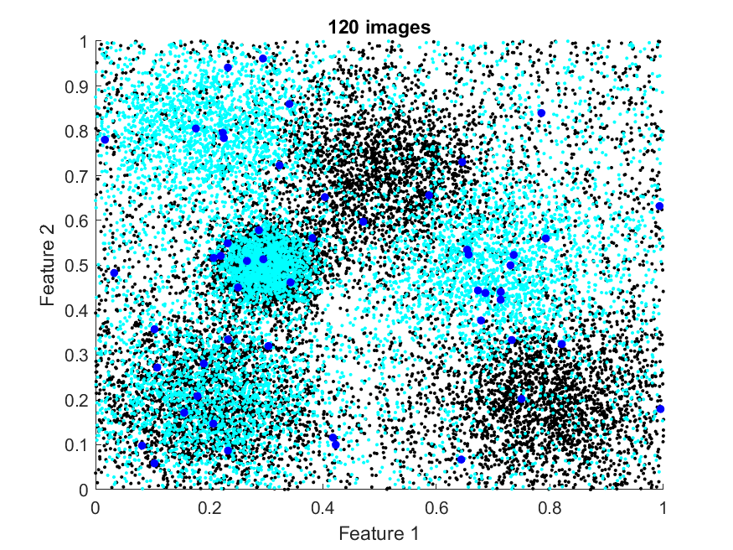
Distribution of patch features (baseball)

Slide 72

Distribution of patch features (baseball)

Slide 73
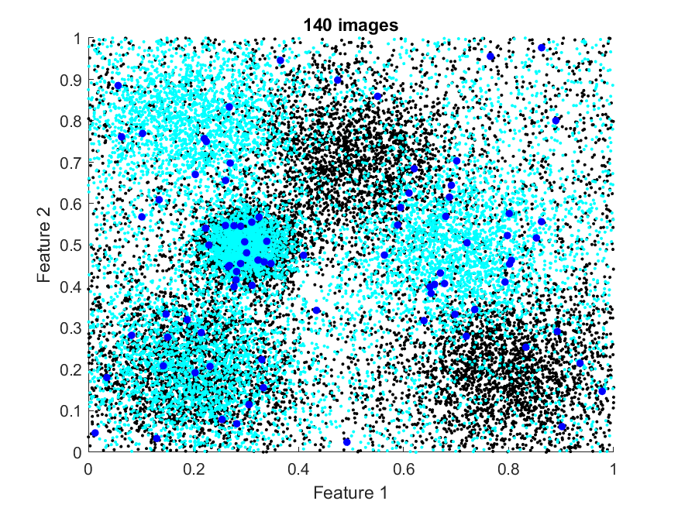
Distribution of patch features (baseball)

Slide 74
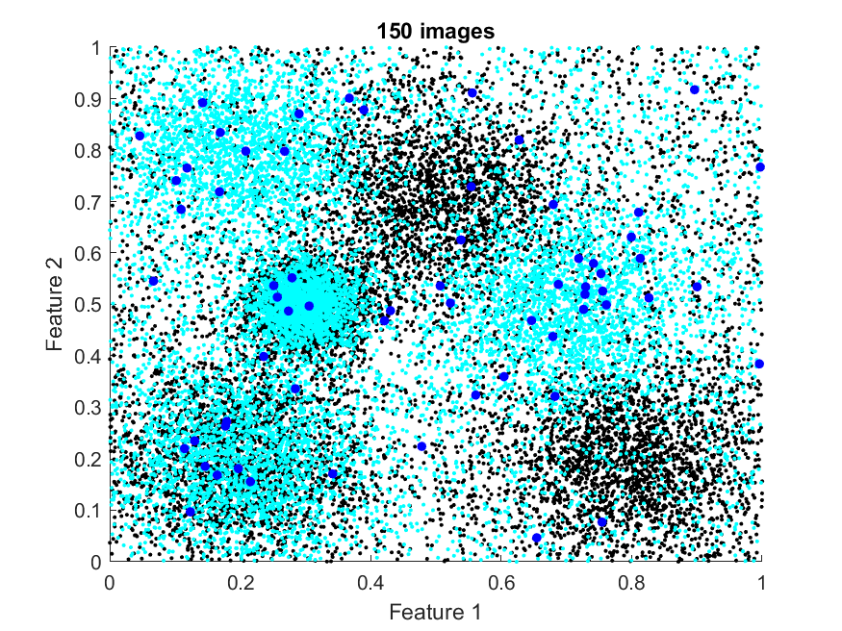
Distribution of patch features (baseball)

Slide 75
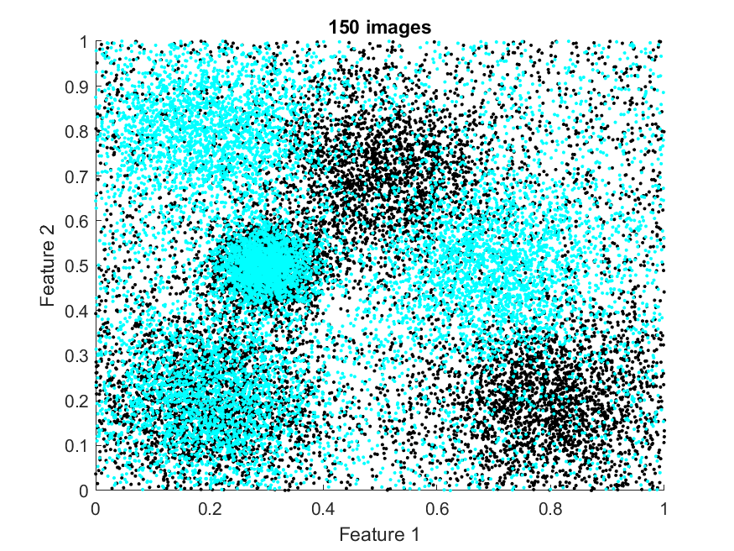
Distribution of patch features (baseball)
Full video available on Moodle

Slide 76
Ideas
You can see that new clusters have become visible in the feature space
There are certain kinds of feature that tend to recur in these “baseball” images
They aren’t exactly the same…
But they are similar…

Slide 77
Ideas
Some of them are completely new (features that don’t appear in “basketball” images)
Some of them are overlapping with existing clusters (features that also appear in “basketball” images)

Slide 78
Ideas
Back to our original idea…
New idea: use all the clusters to simplify our representation of each image from any class
Find each of the clusters, give them each a unique number, e.g., {1, 2, 3, 4, 5, 6}
For every feature patch, just record which cluster it lies closest to…
I = {5, 2, 1, 5, …, 3}

Slide 79
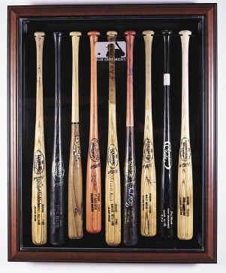
Ideas
Can then represent an image of any size and from any class with a histogram showing the fraction of patches in each cluster…
…Nice because images of different sizes and from different classes now live in the same feature space…
Here a 6D space…
% of patches
Cluster number
% of patches
Cluster number

Slide 80
Ideas
Clusters 1 and 4 tend to be low for basketball images
Can then represent an image of any size and from any class with a histogram showing the fraction of patches in each cluster…
…Nice because images of different sizes and from different classes now live in the same feature space…
Here a 6D space… where different classes are distinctive
% of patches
Cluster number
Clusters 2 and 6 tend to be low for baseball images
% of patches
Cluster number

Slide 81
Ideas
Clusters 1 and 4 tend to be low for basketball images
Can then represent an image of any size and from any class with a histogram showing the fraction of patches in each cluster…
…Nice because images of different sizes and from different classes now live in the same feature space…
Here a 6D space… where different classes are distinctive
% of patches
Cluster number
Clusters 2 and 6 tend to be low for baseball images
% of patches
Cluster number

Slide 82
“Visual words”
Honda said the move was due to global changes in the car industry and
…
No. of occurrences
…
the
and
or
there
When thinking about written documents, we know we can always break them down into their component building blocks: words
Easy to get to a histogram-based representation
With images it’s more difficult: there is no equivalent of these repeating “building blocks”
The process of identifying and numbering unique clusters in the feature space for a given set of image classes is the process of finding “visual words”…
…A common “vocabulary” of visual features that tend to recur in images of the objects you’re interested in

Slide 83
A “bag”
Honda said the move was due to global changes in the car industry and
…
% of patches
No. of occurrences
…
Cluster number
the
and
or
there
Note that we’ve thrown away any information we had about where these visual features appear…
…In either relative or absolute terms
We know they tend to appear somewhere in images of these objects, but have no idea where
The word “bag” is used to capture the idea that we know the features are in there, but not anything about how they’re organised
Bag of words – we don’t know where words are within the document
Bag of visual words – we don’t know where visual words are within the image

Slide 84
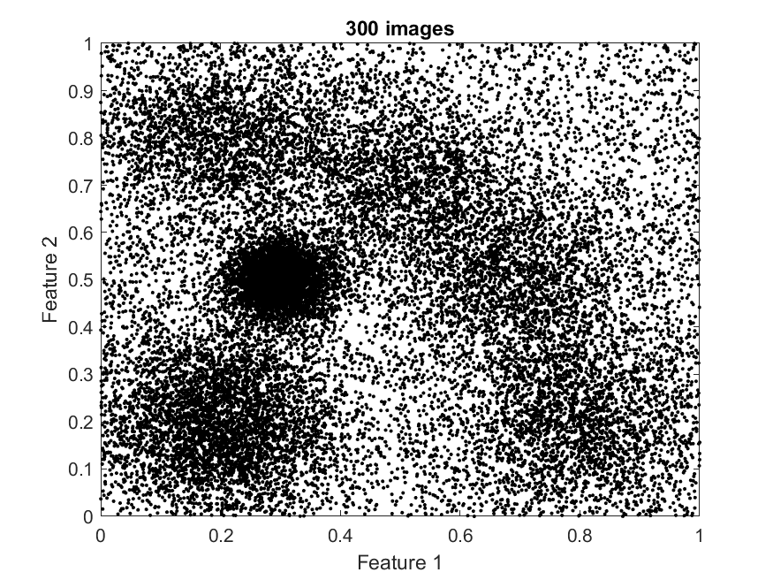









A bag of visual words: end to end
Class 1 images
…
Class 2 images
…
…
Class N images
…

Slide 85

A bag of visual words: end to end
Class 1 images
…
Class 2 images
…
…
Class N images
…

Slide 86

A bag of visual words: end to end
Class 1 images
…
Class 2 images
…
…
Class N images
…

Slide 87

A bag of visual words: end to end
Class 1 images
…
Class 2 images
…
…
Class N images
…

Slide 88
A bag of visual words: end to end
Class 1 images
Class 1 histograms
…
…
Class 2 images
Class 2 histograms
…
…
…
…
Class N images
Class N histograms
…
…

Slide 89
A bag of visual words: end to end
Class 1 images
Class 1 histograms
…
…
Class 2 images
Class 2 histograms
…
…
…
…
Class N images
Class N histograms
…
…
Classifier

Slide 90


A bag of visual words: end to end
A new testing image

Slide 91

A bag of visual words: end to end
A new testing image

Slide 92
A bag of visual words: end to end
A new testing image
A new testing histogram
% of patches
Cluster number

Slide 93
A bag of visual words: end to end
A new testing image
A new testing histogram
% of patches
Cluster number
Classifier

Slide 94
A bag of visual words: end to end
A new testing image
A new testing histogram
% of patches
Cluster number
Classifier
Prediction

Slide 95
Problems
We’ve got a nice strategy, but…
“Find each of the clusters, give them each a unique number, e.g., {1, 2, 3, 4, 5, 6}”
This might be OK for us to do visually…
…But what about doing it automatically…
…And what if the clusters aren’t as neat…
…And what if the space is high-dimensional, and we can’t see what’s going on…
In the more general case: this simple-sounding problem… is hard!

Slide 96
The K-means algorithm
This was the focus of the reading from Lantz
[Make time to have a look if you didn’t do it]
K-means: an algorithm for identifying clusters in a big collection of data
Sounds amazing!
But… You have to tell it how many clusters it’s looking for… (You have to set the value of K)
Oh…
But there are ways to try and figure out a good K value by experiment

Slide 97
The K-means algorithm
Randomly guess the locations of the centres of each cluster, then:
Assign each point to the closest cluster centre (using Euclidean distance)
Calculate the average of all the points associated with each cluster
Use the results to update your estimate of the centre of each cluster
Repeat a good* number of times
* We’ll come back to this

Slide 98
The K-means algorithm
Let’s look at the algorithm in operation on our synthetic data
All the basketball image plus all the baseball images
We’ve looked carefully at the distribution in previous slides and we know K=6 is a good choice…
…So we’ll initialise the algorithm with 6 randomly guesses cluster centres

Slide 99
The K-means algorithm

Slide 100

The K-means algorithm
(One guess is out of sight over here…)

Slide 101

The K-means algorithm

Slide 102

The K-means algorithm

Slide 103

The K-means algorithm

Slide 104

The K-means algorithm

Slide 105

The K-means algorithm

Slide 106

The K-means algorithm

Slide 107

The K-means algorithm

Slide 108

The K-means algorithm

Slide 109

The K-means algorithm

Slide 110

The K-means algorithm

Slide 111

The K-means algorithm

Slide 112

The K-means algorithm

Slide 113

The K-means algorithm

Slide 114

The K-means algorithm

Slide 115
The K-means algorithm
Full video available on Moodle

Slide 116
The K-means algorithm in Matlab
See for practice questions: [memberships, clusters] = kmeans(data,k,'Start','uniform');
Performs K-means clustering on the values in data, using a particular value of k
The name-value pair 'Start','uniform' means that the initial guesses for the cluster centres are random (within the min/max of the data)
memberships = an array of indices, mapping each row of data to the cluster it belongs to
clusters = a matrix containing the coordinates of the cluster centres (sometimes called “centroids”) one cluster per row

Slide 117
Choosing K
The example was interesting, but we could look at the data to make a sensible estimate of the value of K visually…
…What about the more general case
Data may be high-dimensional (>>2D)
Much harder to visualise…

Slide 118
Choosing K
Idea: in a “good” cluster, all the points tend to be similar (high homogeneity, low heterogeneity)
You read in Lantz that there are different measures of homogeneity/heterogeneity
A good measure of heterogeneity is just to just sum up the distances between points in a cluster and the cluster centre
If they are all similar, they will lie nearby, and the sum of distances will be small [low heterogeneity, high homogeneity]
If they are all dissimilar, they will lie far apart, and the sum of distances will be large [high heterogeneity, low homogeneity]

Slide 119
Choosing K
The higher you raise the value of K the greater the homogeneity within clusters
You end up with a single point in every cluster…
“The goal is not to maximize homogeneity or minimize heterogeneity, but rather to find K so that there are diminishing returns beyond that point” [Lantz, Chapter 9]
See for practice questions: Idea of the “elbow plot”
Some measure of heterogeneity plotted against K should trace out the approximate shape of a bent arm
You’re looking for the “elbow” – the kink in the line beyond which the reductions in heterogeneity are less significant

Slide 120
Elbow plots in Matlab
See for practice questions: [memberships, clusters, sumd] = kmeans(data, k, 'Start', 'uniform');
The extra return value sumd holds, for every cluster, the sum of distances between all the points in the cluster and the cluster centre
You can add up all the elements of sumd for an overall picture – in a single number – of homogeneity/heterogeneity in the clustering result
Low sumd = low heterogeneity, high homogeneity [good]
High sumd = high heterogeneity, low homogeneity [bad]

Slide 121
The elbow method
The elbow method provides a good guide…
…But it’s not an exact science
Can be difficult to decide on an exact K…
…But it can certainly help you to get K in the correct range
…And you can always use it for visualisation – even if you’re working in a high-dimensional space
Let’s have a look at an animated elbow plot for our synthetic data (where we know that K=6 is probably the best choice…)

Slide 122

Elbow plot results

Slide 123

Elbow plot results

Slide 124

Elbow plot results

Slide 125

Elbow plot results

Slide 126

Elbow plot results

Slide 127

Elbow plot results

Slide 128

Elbow plot results

Slide 129

Elbow plot results

Slide 130

Elbow plot results

Slide 131

Elbow plot results

Slide 132

Elbow plot results

Slide 133

Elbow plot results

Slide 134
Elbow plot results
Full video available on Moodle

Slide 135
Elbow plot results
Would you have chosen K=6 as the elbow?
Full video available on Moodle

Slide 136
K-Means: other considerations
You can get different answers (for given K) depending on the initialisation
Looking for a global minimum in a possibly multi-modal surface
Worth trying a few different initialisations
See for practice questions: the extra name-value pair 'Replicates',N lets you run the algorithm N times with N different initialisations (for a particular K), and returns the result with the lowest sum(sumd)
You may see Matlab warn about convergence not being reached
This warning is based on whether sum(sumd) is still changing
See for practice questions: you can change the default number of iterations (50) with the name-value pair ‘MaxIter’,M

Slide 137
K-Means: unsupervised learning
The K-means algorithm isn’t only used in BOVW
It’s a very useful and widely used algorithm…
…whenever you have unlabelled data, that you suspect can be broken up into meaningful groups
Unsupervised learning = class labels not available [K-means is the main algorithm]
Supervised learning = class labels available [you know lots of popular algorithms]
E.g., profiling your customers for advertising, recommender systems, …
Lantz’ Chapter 9 example clusters users of a social networking site; is interesting and worth a look if you want to know more (but not needed for the exam)

Slide 138
BOVW: other considerations
Looking for distinctive feature patches within images…
Bland patches featuring small gradients don’t tend to contribute useful information to a visual vocabulary
There are metrics that can be computed from the gradients in a patch to give a measure of how “interesting” it is
E.g., does it contain: an edge, a corner, a ridge, a blob, …
These measures are built in to many of the patch-based representations (e.g., SURF, SIFT, …)…
…And it’s easy to ask for the only the most interesting patches, rather than all the patches [you’ll see this if you try the BOVW tutorial]

Slide 139
BOVW: other considerations

Slide 140
BOVW: other considerations
If you go down this route, it’s harder to keep the number of feature patches coming from each class balanced (K-means can struggle to find clusters for a class if it is under-represented)
In grid-based approach, the total number of patches from each class tends to be similar (assuming similar numbers of images in each class, and a similar range of image sizes)
But some objects tend to have more “interesting” features than others (this is a fundamental property of their structure)…
...So if only preserving interesting features, you need to ensure balance (e.g., limit all classes to match the class with the least interesting features) [you’ll see this if you try the BOVW tutorial]

Slide 141
Reading for next week
Brett Lantz, “Machine Learning with R”
Chapter 7: “Black box methods – neural networks and support vector machines”
From the section entitled: “Understanding support vector machines”, up to and including the section entitled “using kernels for non-linear spaces”
Suggested approach (but do whatever works best for you):
Just relax and read through
As ever, we’re interested in the ideas, not the use of R

